Slide 1
Cognitive Status
1/27/2020

Slide 2
Objectives
Recap from last week
Which data elements should be included in the “library” ?

Slide 3
Current State of Cognitive Status
During earlier discussions, initial set of data elements were chosen based on already standardized data elements in Post Acute Care (PAC) and availability of associated Health Information Technology (HIT) codes. Additionally the understanding was that this current framework would be the first iteration.
Chosen data elements:
Short Confusion Assessment Method (CAM)
Screen for delirium
Brief Interview for Mental Status (BIMS)
Screen for cognition
Patient Health Questionnaire (PHQ)
Screen for depression

Slide 4
What is Ideal State of Cognitive Status?
What additional data elements are important to include for a transition of care?
Should we look at tests or individual questions?
Mini Mental State Exam (MMSE) versus “Is the patient oriented to time?”
Should we have a library of cognitive assessments?
Do we need a combination of both?
Should we be reaching out to HIT code organizations for data elements that are important to include but don’t currently have LOINC codes?
1/22/20:
Group decided to pursue a “library” of cognitive assessments because different tests/screens are used in different settings
The chosen profile should not put value on which test/screen is more important. All the tests/screens are important.

Slide 5
Which assessments should be included in the “library” ?
COGNITIVE TESTS/SCREENS | INCLUDE | NOTES
CAM (Currently included) | x
BIMS (Currently included) | x
PHQ (Currently included) | x
Montreal Cognitive Assessment (MoCA)
MMSE
Trail Making Test
Glasgow Coma Scale (GCS)
FOUR Score |  | References needed
Ranchos
Mini Cog Test |  | Identifies cognitive impairment. Can be administered in 3 minutes. https://mini-cog.com/
St Louis University Mental Status Exam (SLUMS)
Brief Cognitive Assessment Test (BCAT) |  | Identifies cognitive and memory impairments. Short Form is administered in 3 minutes or less. BCAT and BCAT-SF scores can be cross-walked to the BIMS. https://www.thebcat.com/
Cognitive Performance Test |  | Helps to predict and explain functional capabilities in various contexts, as well as determine the compensatory and safety needs of the client. Based on the Allen Scales http://www.allen-cognitive-network.org/
Functional Assessment Staging Tool (FAST) |  | Used to describe the stages of dementia. Based on the Global Deterioration Scale (GDS)/Reisberg Scale https://geriatrictoolkit.missouri.edu/cog/Global-Deterioration-Scale.pdf https://www.dementiacarecentral.com/aboutdementia/facts/stages/#fast
Rapid Geriatric Assessment |  | Identifies frailty, nutrition status, loss of muscle mass and cognitive function https://www.slu.edu/medicine/internal-medicine/geriatric-medicine/aging-successfully/index.php

Slide 6
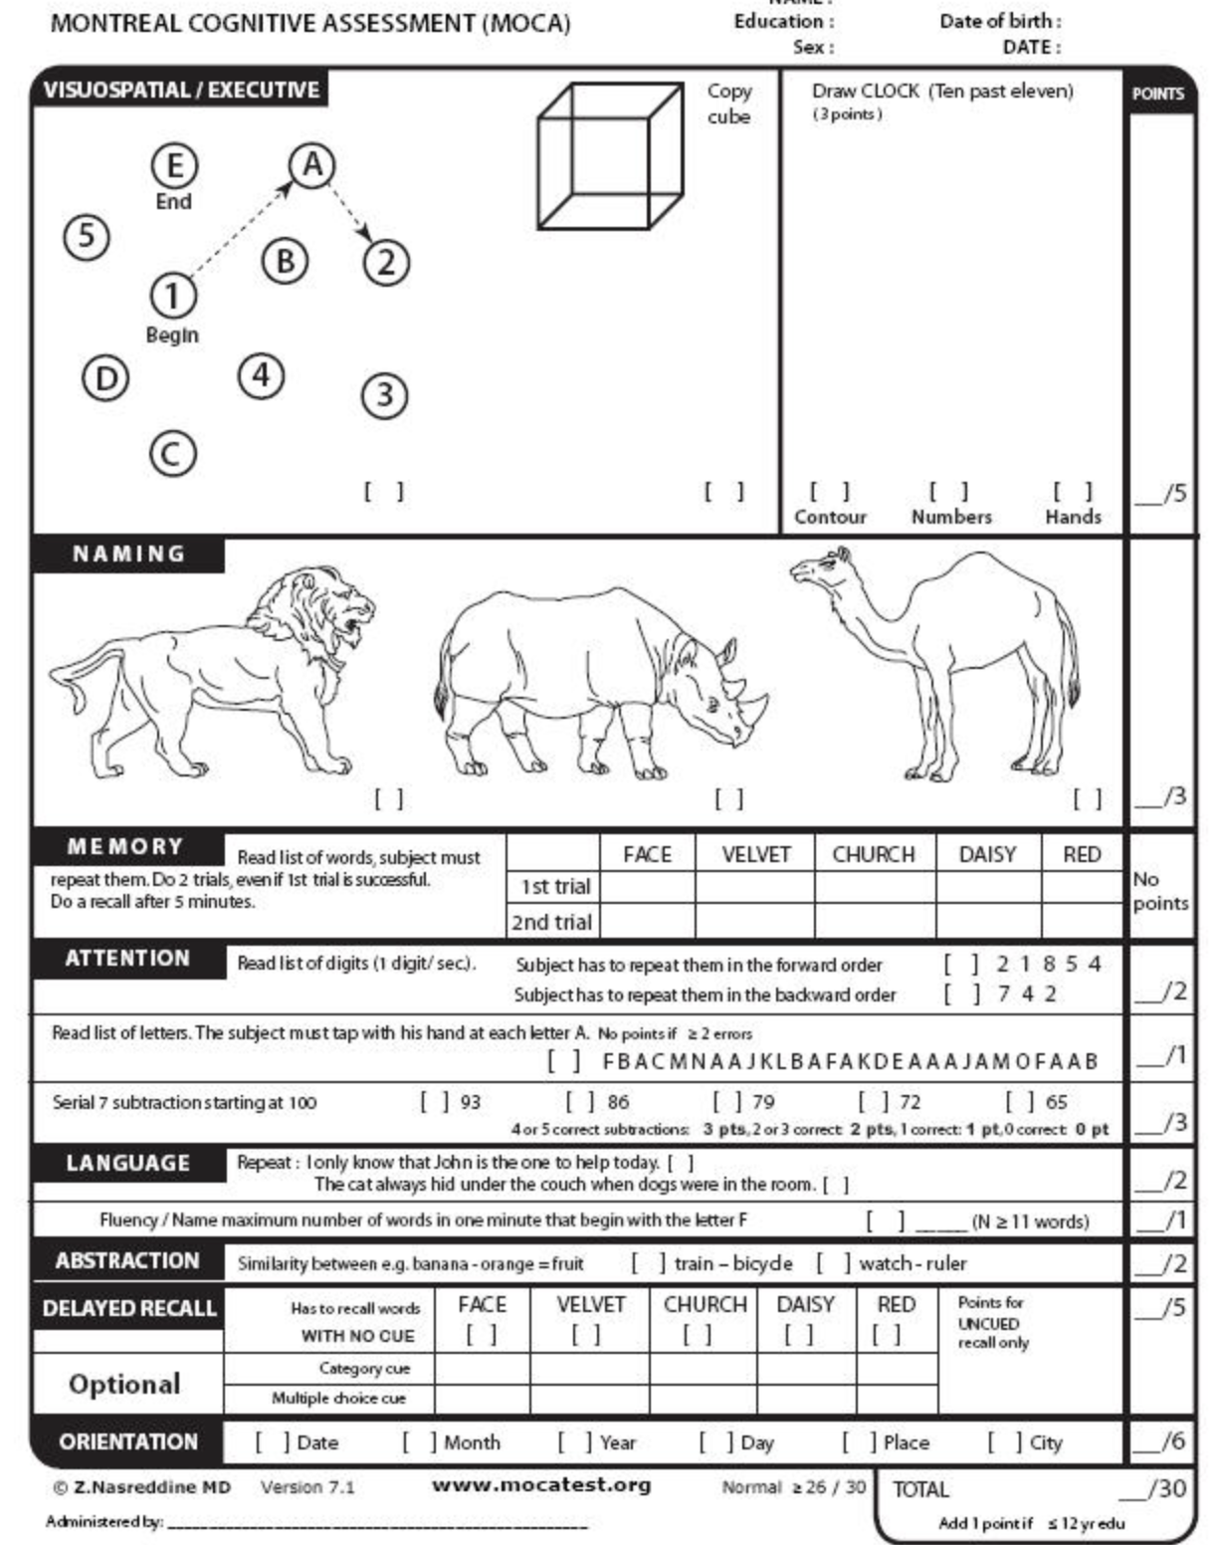
MoCA

Slide 7
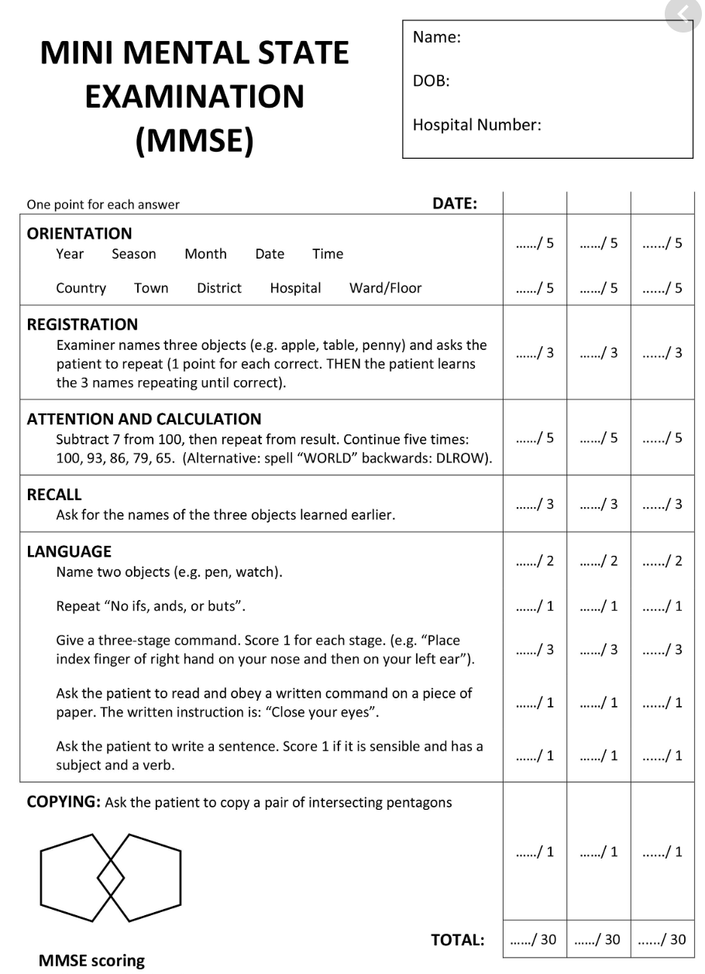
MMSE

Slide 8
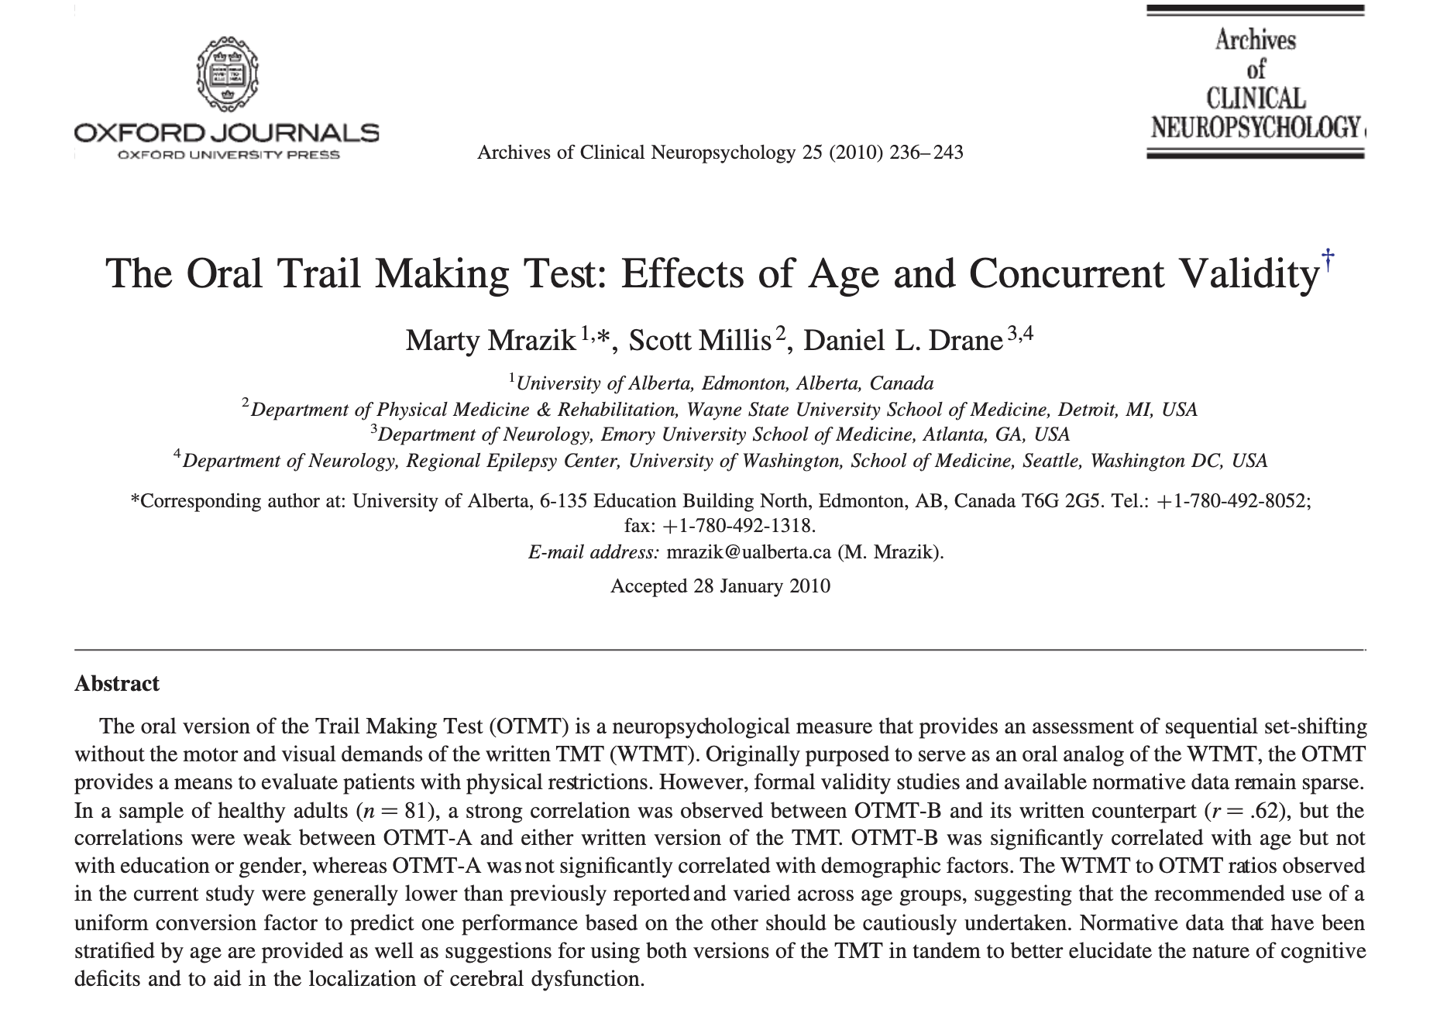
Trail Making Test

Slide 9
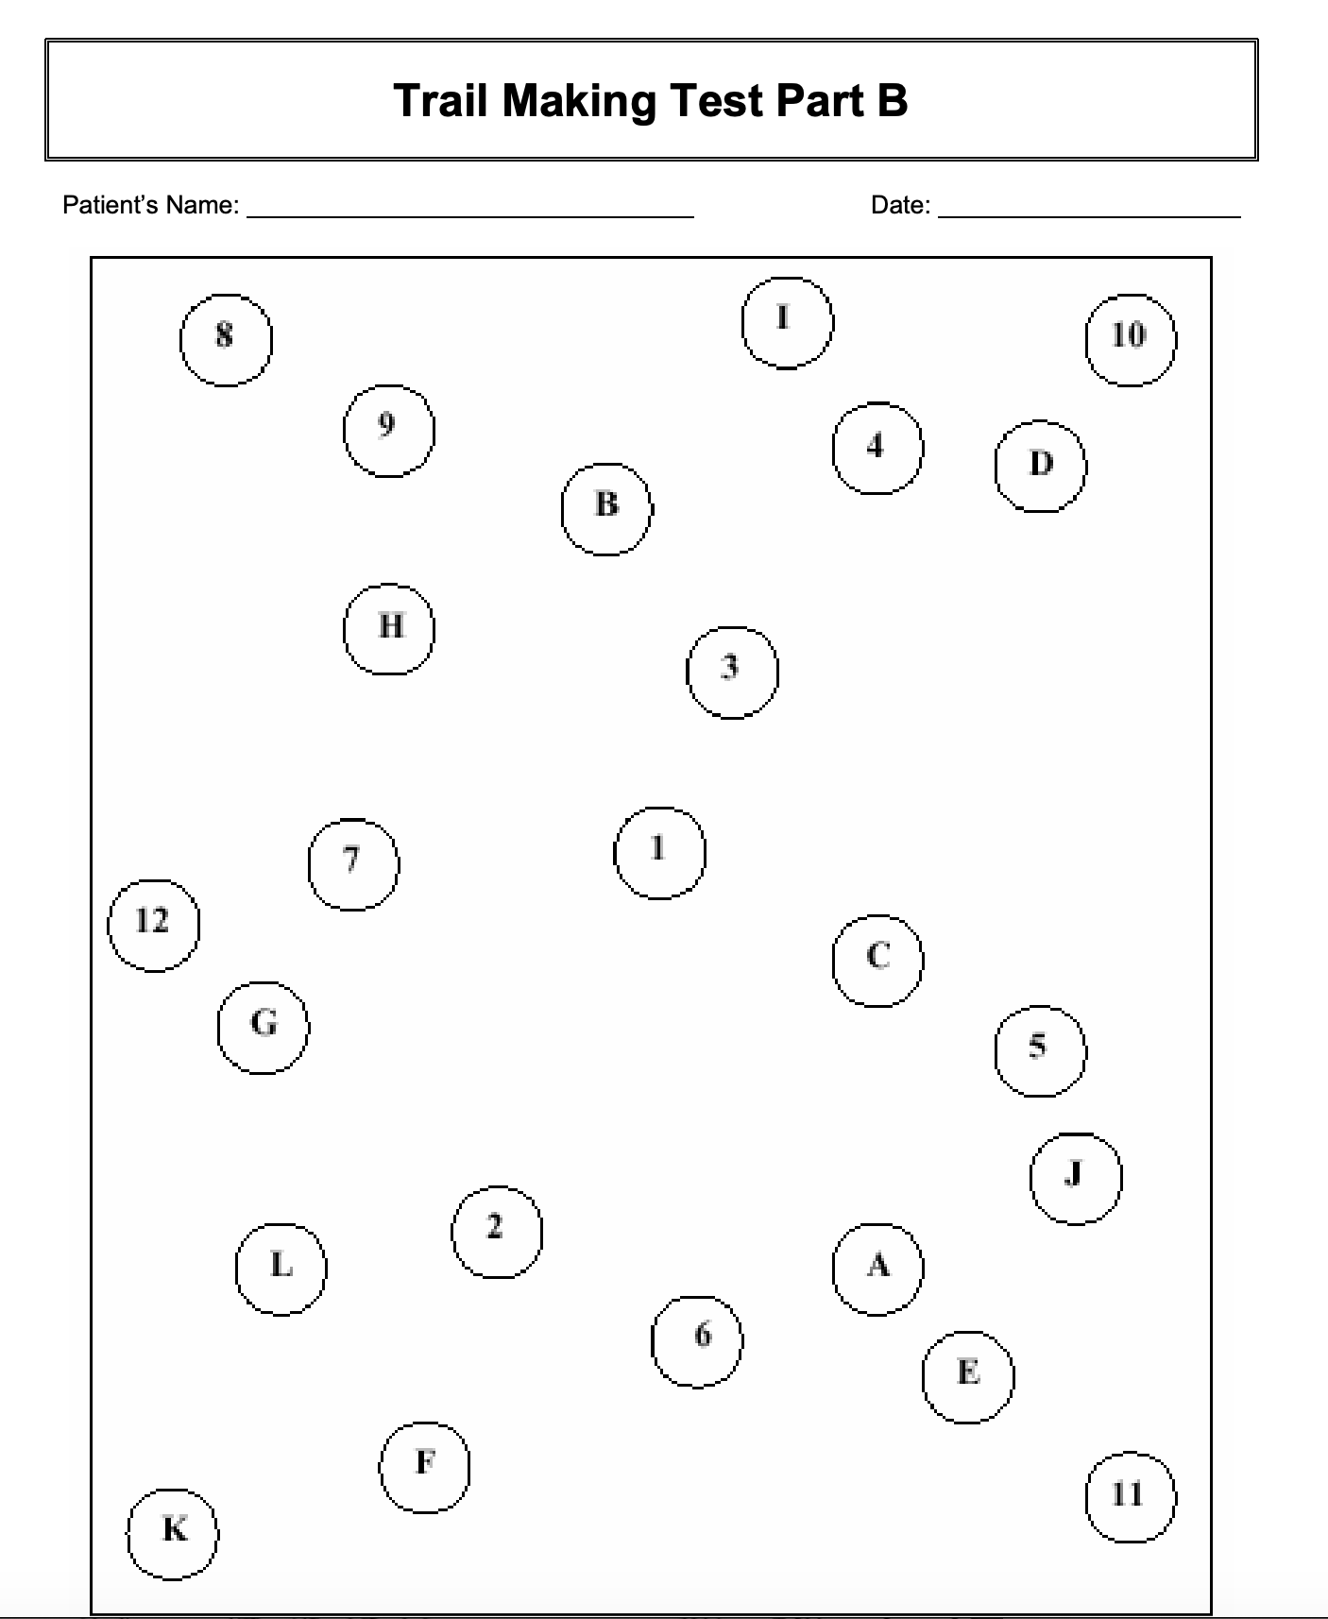
Written Trail Making Test

Slide 10
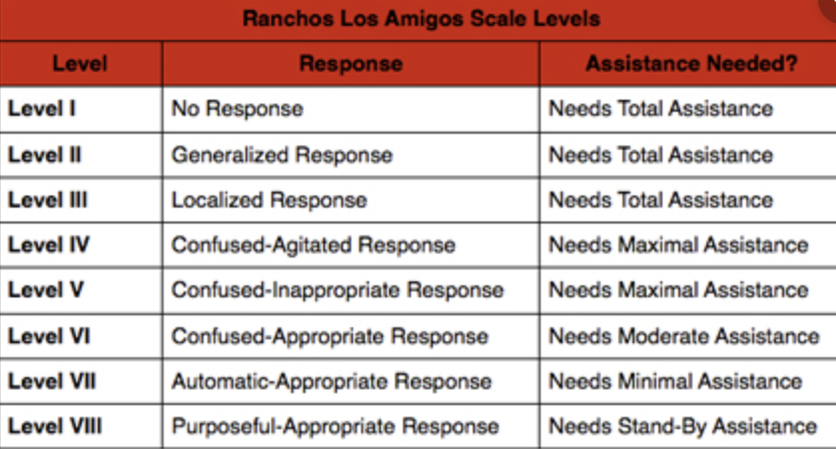
Ranchos – TBI

Slide 11
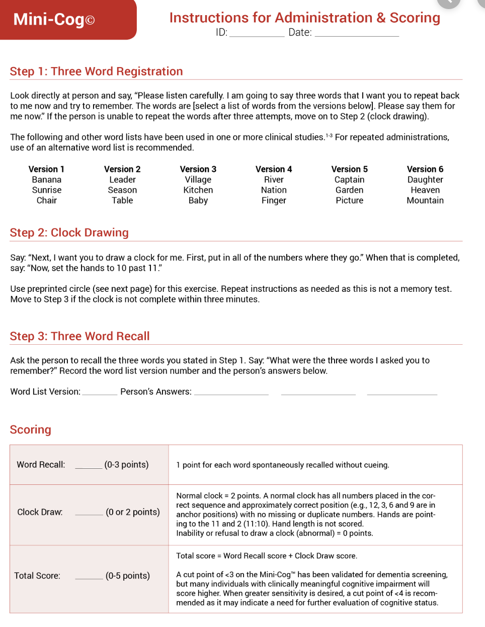
Mini-Cog

Slide 12
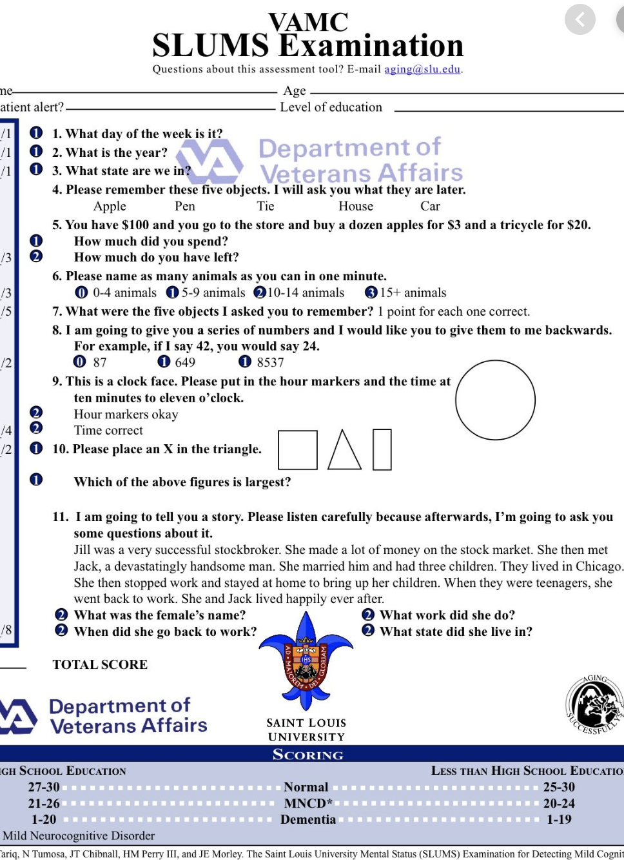
SLUMS

Slide 13
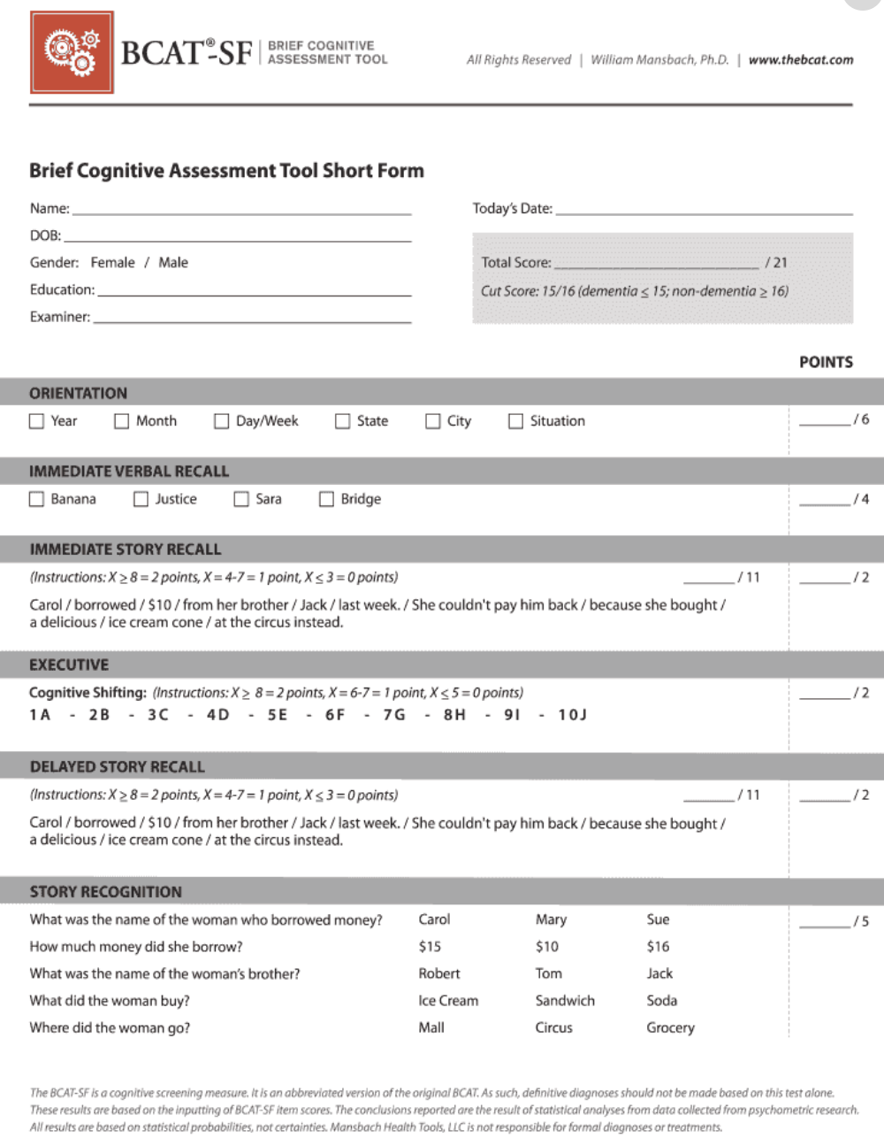
BCAT

Slide 14
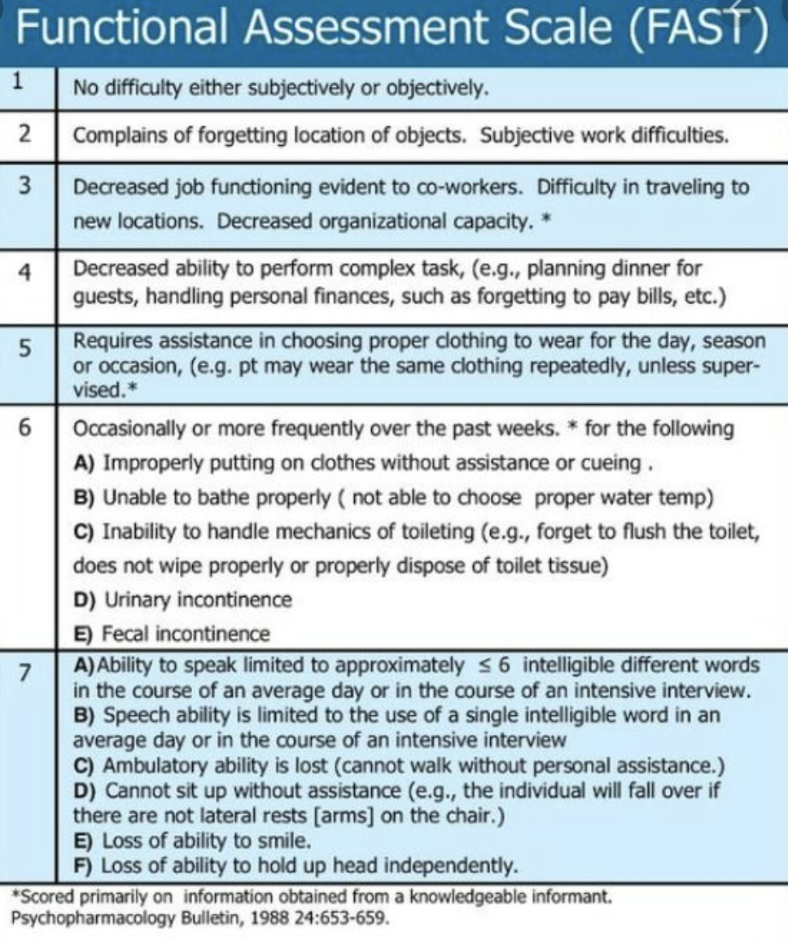
FAST Dementia Scale

Slide 15
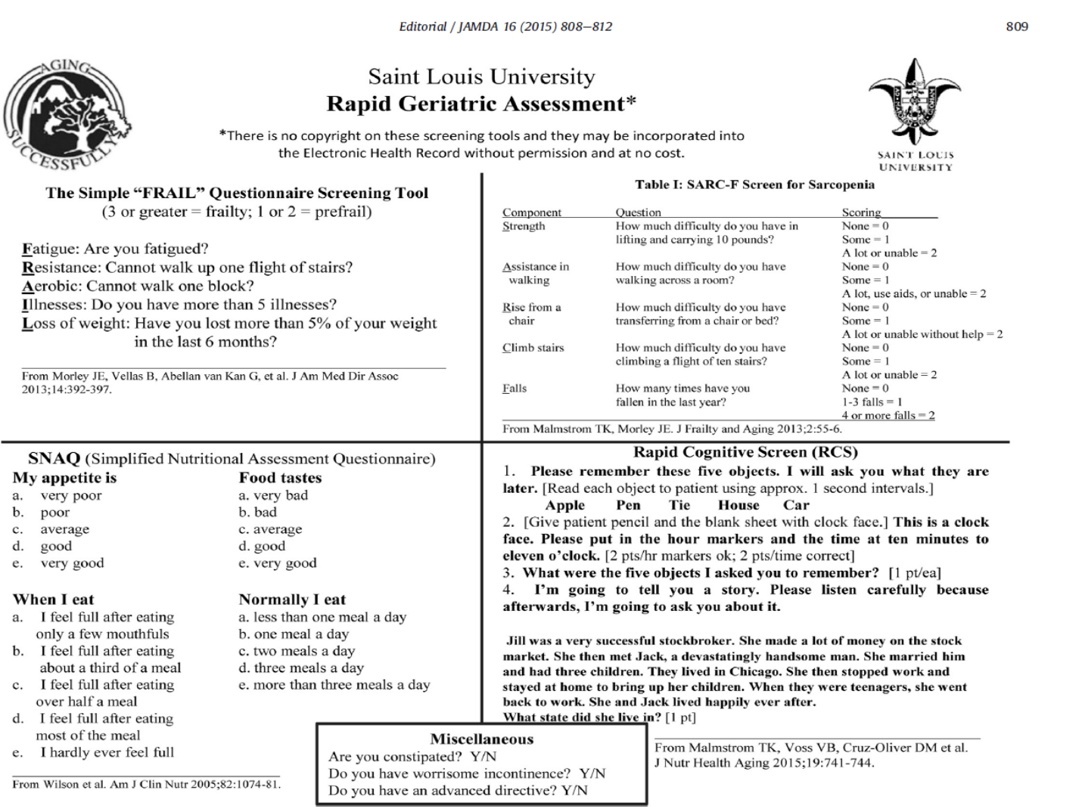
Rapid Geriatric Assessment

Slide 16
Cognitive Performance Test
Unable to find an example

